Slide 1

DAYANANDA SAGAR ACADEMY OF TECHNOLOGY & MANAGEMENT
DEPARTMENT OF COMPUTER SCIENCE AND ENGINEERING
(An Autonomous Institute under VTU)
MINI PROJECT REVIEW 1 - 2023-24
Subject Name | MINI PROJECT | Subject Code | 21CSMP67
Student Name | Praveen Kumar | USN | 1DT22CS411
 | Raghuveer K J |  | 1DT22CS413
 | Sudeep J S |  | 1DT22CS415
 | Vikram S |  | 1DT22CS416
Domain | Web dev, PHP,Mysql | Group No: | C 18
Project Title | Online Quiz
Guide Name | Kalpa R

Slide 2
Agenda
Introduction
Literature Survey
Objective
Problem Statement
Methods
Design/Approach:
Analysis:
References

Slide 3
Introduction
On-line examinations contents providers to focus on creating effective assessment questions and focusing on exam’s feedback delivery to students. In the paper we present techniques that are pertinent to the elements of assessment process: answers submission, computerized grading, and feedback after submission.
As the modern organizations are automated and computers are working as per the instructions, it becomes essential for the coordination of human beings, commodity and computers in a modern organization.
The administrators , instructor, Students who are attending for online examination can communicate with the system through this projects, thus facilitating effective implementation and monitoring of various activities of Online Examinations like conducting Exams as per scheduled basis and delivering result to that particular use or student . And the details of students who attempted Online Examination are maintained at administrator.

Slide 4
Literature Survey
This application is used to conduct online examination. The students can sit at individual terminals and login to write the exam in the given duration. . The questions have to be given to the students.This application will perform correction, display the result immediately and also store it in database. This application provides the administrator with a facility to add new exams.This application provides the Instructor add questions to the exam, modify questions in the exam in a particular exam. This application takes care of authentication of the administrator,Instructor as well as the student.

Slide 5
Introduction - Objectives
The objective of the Online Examination Tool is to provide better information for the users of this system for better results for their maintainence in student examination schedule details and grading details.
Software Requirements: -
Operating System : Windows
Web-Technology: PHP
Front-End: HTML,CSS,JAVASCRIPT
Back-End: MySQL
Web Server: Apache SERVER.

Slide 6
Problem Statement
PROBLEM STATEMENT ONLINE QUIZ is a software developed to conduct an Online Quiz based on time constraints. Quiz System is accessed by entering the username and e-mail id which is added to the database. Before start of the Quiz, the rules and regulations are displayed that includes description of time limit, number of questions to be answered and scoring methods. Quiz is started by displaying ten questions with four options each based on category chosen ie General Knowledge, Verbal Reasoning and Computer Science. If the answer is correct, score is incremented by two and no negative marks for wrong answers. If the time exceeds 10 minutes or all the questions are answered the quiz is stopped .Final score will be displayed and updated in the database with username.

Slide 7
Methods
Design Approach
Analysis

Slide 8
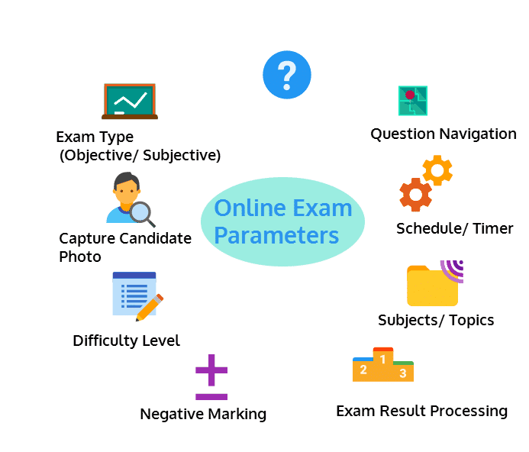
Design Approach
Design is the first step in the development phase for any techniques and principles for the purpose of defining a device, a process or system in sufficient detail to permit its physical realization.
Once the software requirements have been analyzed and specified the software design involves three technical activities - design, coding, implementation and testing that are required to build and verify the software.

Slide 9
Analysis
User Roles: The system supports multiple user roles, including students and teachers.
Quiz Creation: Teachers can create quiz with customizable questions, multiple-choice options, and correct answers.
Quiz Taking: Students can take quiz online and receive instant results.
Result Tracking: Both students and teachers can track quiz results and view historical performance.
User-Friendly Interface: A user-friendly interface enhances the overall user experience.
Data Management: Teachers can manage questions, quizz, and results efficiently.
Responsive Design: The system adapts to various devices, including computers, tablets, and smartphones.

Slide 10
References
Books Referred:
BEGINNING PHP 5 ---DAVE MERCER
BLACK BOOK HTML ---WILEY DREAMTECH
PHP AND MYSQL WEB DEVELOPMENT ---LUKEWELLING,LAURA
MICROSOFT SQL SERVER-2000 ---RANKIN, PAUL & JENSEN
SQL SERVER-2000 ---DUSAN PETKOVIC
PHP IN A NUTSHELL --- PAUL HUDSON
Websites Referred: http://www.projectworlds.in

Slide 11
Thank You

